Slide 1
User’s Guide to Sales Forecast modeling
Paola Aleman Ordaz and Kangyu Mark Wang
29 September 2019

Slide 2
As the final product of our summer internship in 2019, Paola and Mark is happy to present to PriceSmart Inc. their sales forecast solution which combines traditional time-series and machine learning models and cuts weekly forecast root mean squared error (RMSE) by one third to half.
Two R markdown files are included in the solution package. The Training markdown file identifies the best performing ones. The Forecasting markdown file in turn uses a combination of the best performing models to make predictions.
We would like to sincerely thanks Professor Gordon Hansen, Mr. Daniel Kawer and Mr. Danny Alpizar for their help to our internship. Without them this solution would not have been possible.

Slide 3
Logic flow
2. Data input: Training markdown
More than two year of sales without significant periods of missing data
3. Performance of models: Training markdown
Train models on the training set (de-trend and de-seasonalize data when necessary)
4. forecasting: Forecasting markdown
Re-train best performers on the whole existing dataset, which now serves as training (traditional)/training and validation (machine learning) set
Other input variables of the item, as well as category level variables
1. Identification of forecast goals: Training markdown
Unit of analysis: single items in one club
Period of forecast:
Length of inventory: time period from the placement of order to arrival of goods to clubs
Length of prediction: time period from one window of purchase decision making to the next
Divide existing data into training (traditional)/training and validation (machine learning) and test sets
Apply models to the test set and rank their performances
Identify the four best-performers to be used in forecast
Combine them to make predictions

Slide 4
Use of two markdown files
Parameters and values need to be modified before running the two markdown files.
Training markdown
Section | Line | Parameter or value | Meaning
Setup |  | Working directory | Working directory should be set to the folder named “Forecast”. The two markdown files are stored there.
Setup |  | len_inv | time period from the placement of order to arrival of goods to clubs
Setup |  | len_dec | Time period from one window of purchase decision making to the next.
Importing Training Dataset |  |  | Existing file should be loaded into the universal environment
Loading the Categorical Sale |  | category | Categorical data should be loaded into the universal environment
Identify Seasonality and create time series |  | Season1, season2, season3 | Seasons used as Fourier regressors
Machine learning setup |  | t_v_c1k | Dataset with engineered features, can add more log variables

Slide 5
Use of two markdown files
Parameters and values need to be modified before running the two markdown files.
Forecasting markdown
Section | Line | Parameter or value | Meaning
Prepare data |  | Working directory | Working directory should be set to the folder named “Forecast”. The two markdown files are stored there.
Prepare data |  |  | Existing file should be loaded into the universal environment
Identify seasons |  | Season1, season2, season3 | Seasons used as Fourier regressors
Machine learning setup |  | t_v_c1k | Dataset with engineered features, can add more log variables. Should be

Slide 6
1. Identification of forecast goals
Unit of analyses: define parameters in Training markdown
item <- "Kitchen Trash Bag"
club <- 6101
country <- "Colombia“
Period of forecast: define parameters in Training markdown
len_inv<-17 #It takes 17 weeks for a place order to reach its destination in the club. Therefore, buyers need to think 17th week into the future.
len_dec<-1 #Buyers make decisions every week on this item. Therefore, they only need to consider sales in the 18th week.

Slide 7
2. Data input
More than two year of sales without significant periods of missing data
Traditional models involve de-seasonalizing, and thus there should be at least two periods (years) of data
Technically, sales data should not be missing for a complete week: otherwise the code will not run.
Attention should be paid to missing sales data to prevent distortion to forecasts.
Our solution does not involve any modification to sales value. Any modification should be based on real-world situations and prediction needs
Other input variables of the item:
transaction_avrg
members_avrg
sales_local_avrg
exchange_rate_avrg
sales_usd_avrg
category level variables:
category_sales_local_avrg
category_sales_usd_avrg
category_quantity_avrg

Slide 8
2. Data input
De-trending and de-seasonalizing
Use stl function in R
Apply to logged sales
s.window, which indicates the span (in lags) of the loess window for seasonal extraction, is set to 13
t.window, which indicates the span (in lags) of the loess window for trend extraction, is set to 13
Identification of seasons
Use periodogram function in R
The seasons detected are only rough estimates and we need to use knowledge about annual time series to determine the seasons.
52.14, the number of weeks per year, is always included
Only periods shorter than 52.14 should be included, and their length should be adjusted to its closest whole-month length. For example, if 13.02 is reported is a strong period by Fourier transformation, 12.53 (three months) should be the season used in analyses.
none period should be multiple of the other (otherwise Fourier regressor does not work). Therefore, half-year period is changed from 26.07 to 25.07 weeks. We believe better ways to deal with this problem exist.

Slide 9
3. Performance of models
Traditional models
Simple ARIMA
Apply to de-trended and de-seasonlized data
Use auto.arima function in R, which searches through combinations of order parameters and picks the set that optimizes model fit criteria
ARIMA double season
Use to de-trended and de-seasonlized data
Use the first and second periods identified as Fourier regressors, and tune the K parameter (Maximum order of Fourier terms).
ARIMA single season
Apply to de-trended and de-seasonlized data
Use annual season, and tune the K parameter (Maximum order of Fourier terms).
Traditional models
Naïve method
Apply to de-trended and de-seasonlized data
Use the most recent observation as forecast into the future
Average method
Apply to de-trended and de-seasonlized data
Use the average of the historical data as forecast into the future
Seasonal naïve method
Apply to de-trended and de-seasonlized data
Set each forecast to be equal to the last observed value from the same day of the last year
Drift method
Apply to de-trended and de-seasonlized data
allow the forecasts to increase or decrease over time, where the amount of change over time (called the drift) is set to be the average change seen in the historical data.

Slide 10
3. Performance of models
Traditional models
TBATS: annual
No need to de-trend and de-seasonalize data
Use 52 week (annual) seasons
TBATS: 1, 2
No need to de-trend and de-seasonalize data
Use first and second seasons
TBATS: 2, 3
No need to de-trend and de-seasonalize data
Use second and third seasons
TBATS: 1, 3
No need to de-trend and de-seasonalize data
Use first and third seasons
TABTS: non-seasonal
No need to de-trend and de-seasonalize data
Use default setting
Traditional models
Neural Network: de-trended and de-seasonalzied
Apply to de-trended and de-seasonalized data
p parameter (embedding dimension) set to the optimal number of lags (according to the AIC) for a linear AR(p) model applied to seasonally adjusted data (from an stl decomposition).
P parameter (number of seasonal lags used as inputs) set to 1
Size parameter (number of nodes in the hidden layer) set to half of the number of input nodes plus 1
Repeats parameter (number of networks to fit with different random starting weights) set to 20
Lambda parameter (Box-Cox transformation parameter) set to “auto”, a transformation is automatically selected using BoxCox.lambda
Neural Network: raw
No need to de-trend and de-seasonalize data
p parameter (embedding dimension) set to the optimal number of lags (according to the AIC) for a linear AR(p) model applied to seasonally adjusted data (from an stl decomposition).
P parameter (number of seasonal lags used as inputs) set to 1
Size parameter (number of nodes in the hidden layer) set to half of the number of input nodes plus 1
Repeats parameter (number of networks to fit with different random starting weights) set to 20
Lambda parameter (Box-Cox transformation parameter) set to “auto”, a transformation is automatically selected using BoxCox.lambda

Slide 11
3. Performance of models
Machine learning method
No need to de-trend and de-seasonalize data for machine learning models
XG Boost
Use mlr package
Tuning parameter:
nrounds (number of trees in the model)
max_depth (number of splits in each tree)
eta (shrinkage)
lambda (L2 regularization)
Random forest 1
Use randomForest function in randomForest package
ntree (number of trees to grow) set to 1000
mtry (number of variables randomly sampled as candidates at each split) set to 3
nodesize (minimum size of terminal nodes) set to 3
Machine learning method
Random forest 2
Use caret package
Tuning parameter:
mtry (number of variables randomly sampled as candidates at each split)
maxnode (maximum number of terminal nodes trees in the forest can have)
ntree (number of trees to grow)
Random forest 3
use randomForest function in randomForest package
use the same parameter as in Random Forest 2

Slide 12
3. Performance of models
Machine learning method
Ridge
s parameter (lambda parameter) set to lambda.1se (the most regularized model such that error is within one standard error of the minimum)
LASSO
s parameter (lambda parameter) set to lambda.min (lambda that achieves lowest standard error)
Elastic Net
tuning the alpha parameter

Slide 13
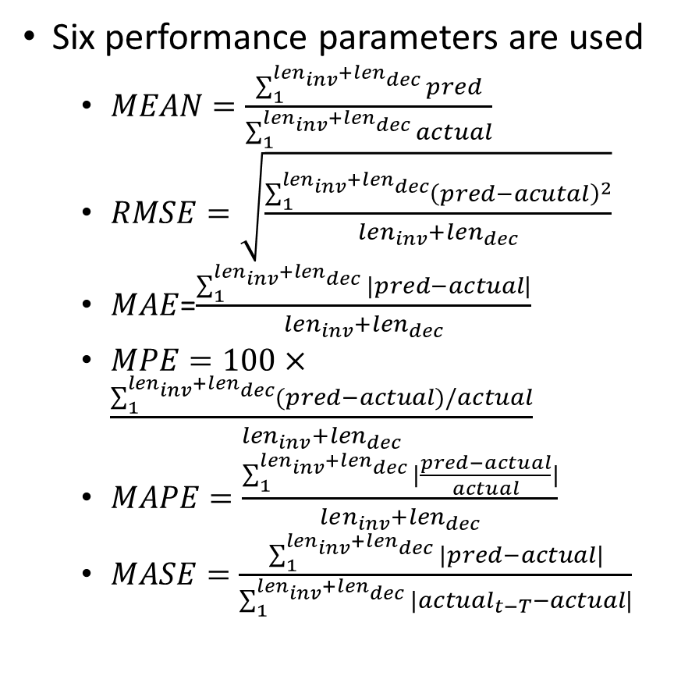
3. Performance of models
Six performance parameters are used
$MEAN=\frac{\sum_{1}^{len_{inv}+len_{dec}}{pred}}{\sum_{1}^{len_{inv}+len_{dec}}{actual}}$
$RMSE=\sqrt{\frac{\sum_{1}^{len_{inv}+len_{dec}}{{\left(pred−acutal\right)}^{2}}}{len_{inv}+len_{dec}}}$
$MAE$=$\frac{\sum_{1}^{len_{inv}+len_{dec}}{|pred−actual|}}{len_{inv}+len_{dec}}$
$MPE=100×\frac{\sum_{1}^{len_{inv}+len_{dec}}{(pred−actual)/actual}}{len_{inv}+len_{dec}}$
$MAPE=\frac{\sum_{1}^{len_{inv}+len_{dec}}{|\frac{pred−actual}{actual}|}}{len_{inv}+len_{dec}}$
$MASE=\frac{\sum_{1}^{len_{inv}+len_{dec}}{|pred−actual|}}{\sum_{1}^{len_{inv}+len_{dec}}{|actual_{t−T}−actual|}}$
Best performers are identified by RMSE
Final prediction is the arithmetic average of two best traditional models and two best machine learning models

Slide 14
4. Forecasting
All models should be re-trained using the whole existing data
Parameters will change from the previous section
New models need to be retrained every time new predictions are made
Best performers are identified by RMSE
Final prediction is the arithmetic average of two best traditional models and two best machine learning models

